Slide 1
Employee Data Analysis using Excel
Student Name:S.Keerthana
Register No : 312220251
Department: III B.com General (COmmerce)
College : Jeppiaar College of Arts & Science

Slide 2
PROJECT TITLE
Employee Salary Analysis using Excel

Slide 3


AGENDA
Problem Statement
Project Overview
End Users
Our Solution and Proposition
Dataset Description
Modelling Approach
Results and Discussion
Conclusion
3/21/2024 Annual Review

Slide 4

PROBLEM STATEMENT
To Analyse the Salary of the Employee with the given salary in the Employee Salary Dateset

Slide 5

PROJECT OVERVIEW
Analyse employee salary data to identify trends , patterns, and correlations, examine factors like job role, department, experience and location to understand impact on salary. Visualise findings through charts and graphs to provide insights for informed decision making ensuring fair compensation and optimal resource allocation.

Slide 6

WHO ARE THE END USERS?
Managing Director
Employee
Representative
Board of Members
Managing Director
HR manager
Management

Slide 7

OUR SOLUTION AND ITS VALUE PROPOSITION
Conditonal Formatting - To Highlight the Blanks cells and font colour of the cell .
Sort & Filter - Remove the Blank Missing Values.
Pivot Table - Summary of Employee Salary from the Company Employee Salary Dataset
Formulas - IFS (To get the Sort out for Job)
Graphs- (Pie Chart) - FINAL REPORT on Employee Salary

Slide 8
Dataset Description
Employee Salary Dataset - Kaggle.com
Features - 8 features
Age- Numerical values
Group - Text Values
ID - Numerical Values
Salary - Numerical Values
Active List - Numerical Values
Salary Analysis - Text Values

Slide 9

THE "WOW" IN OUR SOLUTION
New Formula Used : IFS
To Find out the Salary Analysis for the salary amount given in the dataset .
3/21/2024 Annual Review

Slide 10
MODELLING
Dataset Collection - Employee Salary Dataset
Dataset Preparation - Clearing Blanks, Filtering and Removing Blank data in the Dataset.
Using IFS formula to attain Salary Analysis (1,2,3,4) (Low Salary/High Salary)
Insert Pivot Table to Summarize the Dataset on Employee Salary based on Salary Amount and Analysis
Data Visualization using Pie Chart to represent the Salary of the Employee
Final Report

Slide 11
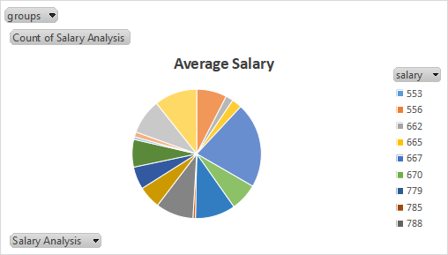
RESULTS

Slide 12
Conclusion
The analysis reveals that the average salary of employees is moderate, with a reasonable range. The majority of employees earn a steady income, while a smaller proportion earn higher or lower salaries. The highest-paid employees earn significantly more, while the lowest-paid employees earn less. Overall, the salary distribution indicates a balanced and equitable compensation structure.

